Slide 1
Python - Basic Operators
Python language supports following type of operators.
  Arithmetic operators - +,-,*
  Assignment operators - =, +=, -=
  Comparison operators - >=, <=, ==, !=, <>
  Logical operators - and, or, not
  Identity operators - is, is not
  Membership operators – in, not in
  Bitwise operators - &, |, ~, >>, <<

Slide 2
Python Arithmetic Operators:
Operator | Description
+ | Addition - Adds values on either side of the operator
- | Subtraction - Subtracts right hand operand from left hand operand
* | Multiplication or Product - Multiplies values on either side of the operator
/ | Division - Divides left hand operand by right hand operand
// | Floor Division - The division of operands where the result is the quotient in which the digits after the decimal point are removed.
% | Modulus - Divides left hand operand by right hand operand and returns remainder
** | Exponent - Performs exponential (power) calculation on operators

Slide 3
Python Comparison Operators:
Operator | Description
== | Checks if the value of two operands are equal or not, if yes then condition becomes true.
!= | Checks if the value of two operands are equal or not, if values are not equal then condition becomes true.
<> | Checks if the value of two operands are equal or not, if values are not equal then condition becomes true.
> | Checks if the value of left operand is greater than the value of right operand, if yes then condition becomes true.
< | Checks if the value of left operand is less than the value of right operand, if yes then condition becomes true.
>= | Checks if the value of left operand is greater than or equal to the value of right operand, if yes then condition becomes true.
<= | Checks if the value of left operand is less than or equal to the value of right operand, if yes then condition becomes true.

Slide 4
Python Assignment Operators:
Operator | Description
= | Simple assignment operator, Assigns values from right side operands to left side operand
+= | Add AND assignment operator, It adds right operand to the left operand and assign the result to left operand
-= | Subtract AND assignment operator, It subtracts right operand from the left operand and assign the result to left operand
*= | Multiply AND assignment operator, It multiplies right operand with the left operand and assign the result to left operand
/= | Divide AND assignment operator, It divides left operand with the right operand and assign the result to left operand
%= | Modulus AND assignment operator, It takes modulus using two operands and assign the result to left operand
**= | Exponent AND assignment operator, Performs exponential (power) calculation on operators and assign value to the left operand
//= | Floor Division and assigns a value, Performs floor division on operators and assign value to the left operand

Slide 5
Python Membership Operators:
In addition to the operators discussed previously, Python has membership operators, which test for membership in a sequence, such as strings, lists, or tuples.
Operator | Description
in | Evaluates to true if it finds a variable in the specified sequence and false otherwise.
not in | Evaluates to true if it does not finds a variable in the specified sequence and false otherwise.

Slide 6
Python Identity Operators:
Operator | Description
is | Returns true if both variables are the same object
is not | Returns true if both variables are not the same object

Slide 7
Python Logical Operators:
Operator | Description | Example
and | Called Logical AND operator. If both the operands are true then then condition becomes true. | (a and b) is true.
or | Called Logical OR Operator. If any of the two operands are non zero then then condition becomes true. | (a or b) is true.
not | Called Logical NOT Operator. Use to reverses the logical state of its operand. If a condition is true then Logical NOT operator will make false. | not(a and b) is false.
True is equal to 1
False is equal to 0

Slide 8
Introduction to Numbering System
Decimal to Binary:
128 64 32 16 8 4 2 1
0 0 0 0 0 0 0 0
10 decimal = 1010 in binary
22 decimal = 0001 0110 = 10110 in binary
117 decimal 117/2 = 58 R 1
        58/2 = 29 R 0
        29/2 = 14 R 1
        14/2 = 7 R 0
        7 /2 = 3 R 1
        3/2 = 1 R 1
        1/2 = 0 R 1 answer = 1110101

Slide 9
Introduction to logical gates
AND (&)
0 | 0 | 0
0 | 1 | 0
1 | 0 | 0
1 | 1 | 1
XOR (^)
0 | 0 | 0
0 | 1 | 1
1 | 0 | 1
1 | 1 | 0
OR (|)
0 | 0 | 0
0 | 1 | 1
1 | 0 | 1
1 | 1 | 1

Slide 10
Python Bitwise Operators:
Operator | Description
& | Binary AND Operator copies a bit to the result if it exists in both operands.
| | Binary OR Operator copies a bit if it exists in either operand.
^ | Binary XOR Operator copies the bit if it is set in one operand but not both.
~ | Binary Ones Complement Operator is unary and has the effect of 'flipping' bits.
<< | Binary Left Shift Operator. The left operands value is moved left by the number of bits specified by the right operand.
>> | Binary Right Shift Operator. The left operands value is moved right by the number of bits specified by the right operand.

Slide 11
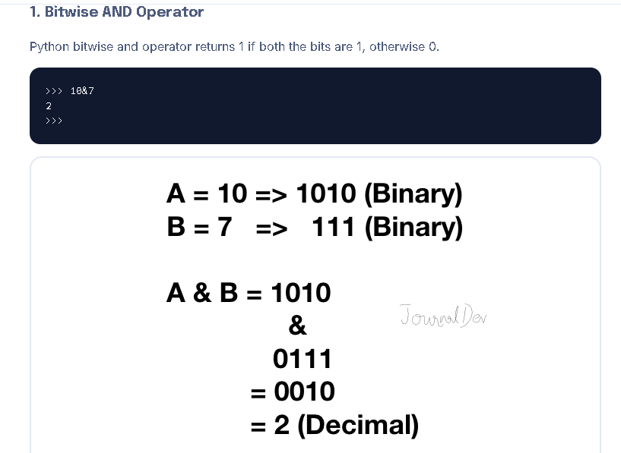
AND (&)
0 | 0 | 0
0 | 1 | 0
1 | 0 | 0
1 | 1 | 1

Slide 12
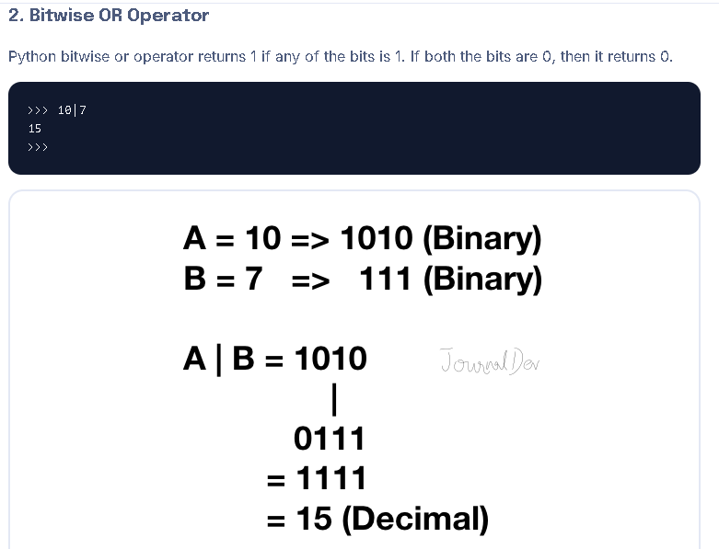
OR (|)
0 | 0 | 0
0 | 1 | 1
1 | 0 | 1
1 | 1 | 1

Slide 13
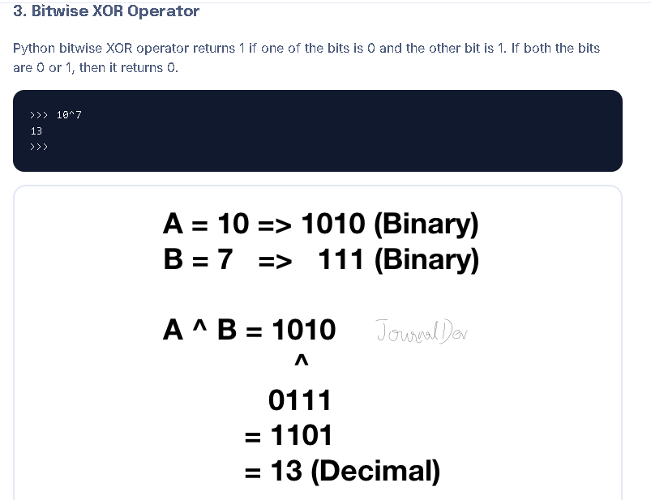
XOR (^)
0 | 0 | 0
0 | 1 | 1
1 | 0 | 1
1 | 1 | 0

Slide 14
Bitwise Ones’ Complement Operator (~)
Steps to follow:
Add 1 to the number
Change the sign
Example 1:
print(~10)
10 + 1 = 11
11 becomes -11
Example 2:
print(~-20)
-20 + 1 = -19
-19 becomes 19

Slide 15
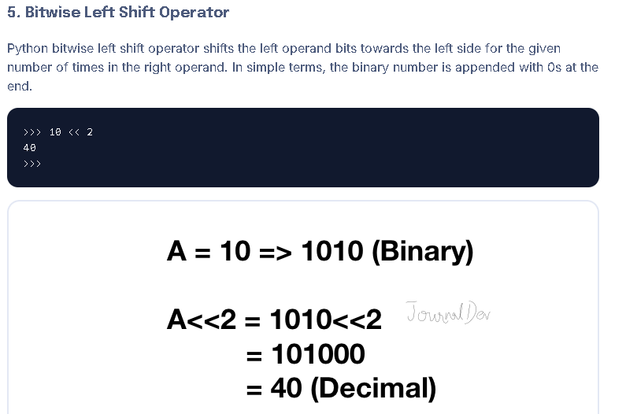

Slide 16
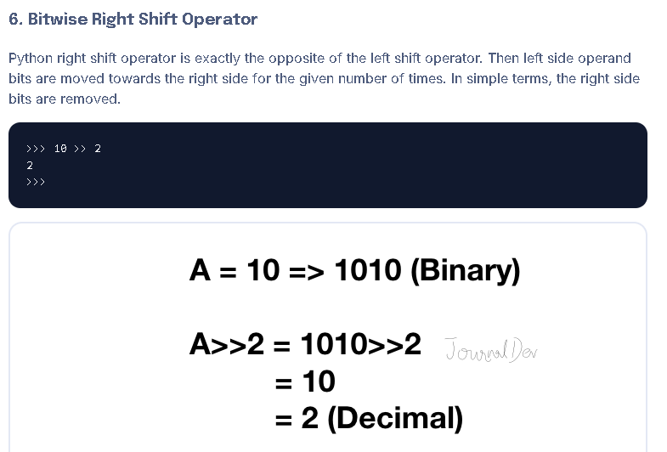

Slide 17
Logical ( and, or)
and operator takes the right value
or operator takes the left value
print(1 and 2) = 2
print(1 or 2) = 1

Slide 18
Python Operators Precedence
Name | Operators
Parentheses | ()
Exponentiation | **
Bitwise Not | ~
Multiplication, Division, Modulo, Integer Division | * / % //
Addition, Subtraction | + -
Bitwise Shift Right and Left | >> <<
Bitwise AND | &
Bitwise XOR and OR | ^ |
Comparison | <= < > >=
Equality | <> == !=
In-Place Assignments | = %= /= //= -= += *= **=
Identity, Membership | is, is not, in, not in
Logical | not, and, or

